Slide 1

Team Fight Tactics Data Analysis: First Look
By Sang Cheon
2020.03.13

Slide 2
Game Background
With the massive growth of e-sports and competitive online games, developers strive to come up with a revolutionary new genre that may shape the future of e-sports. In 2019, a new type of online game, aka “auto-chess” has been on the rise and Riot Games has created a version of their own by the name of Team Fight Tactics with expectations of mobile releases in March 2020.
Team Fight Tactics is a turn-based chess like game for 8 players to compete simultaneously using a shared pool of units.

Slide 3
Problem Statement
A player’s selection of team compositions and building specific units can have a critical role in the the outcome of a random match in TFT. Depending on what strategy an individual takes, a player can gain an advantage over other players slightly. Using multiclass classification models and ensemble methods, we will explore to see if there is a significant evidence that a certain team composition or unit will yield a better placement (1st Place).

Slide 4
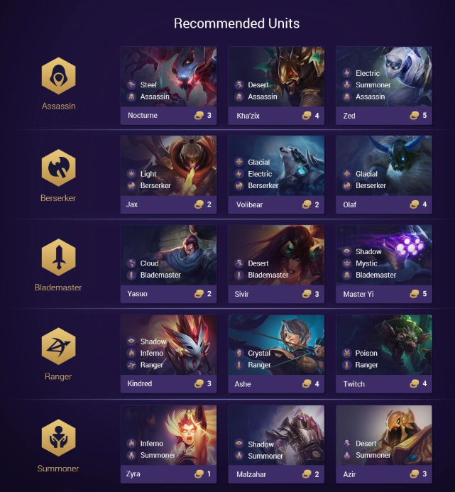
Example Team Compositions
Team Bonuses : 27 different types
Team Bonus Req : 2-6 units
Champion Unit Variants : 56 different champion units

Slide 5
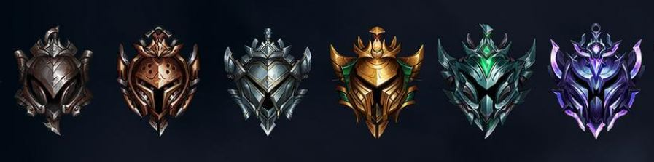
Data Gathering
RIOT API Query
Get all the player’s IDs from different ranking divisions
Get a list of match IDs corresponding to each of the player’s IDs
Get all the match information using the match IDs
Extract team composition & champion unit data
Store the data into a csv file

Slide 6
Data Cleaning & Pre-Processing
Extracted data from RIOT API
Read from csv file
Create dummy columns of feature with binary values
Look for irregularities in our list of features (unobtainable units with null value)
Segregate Champions Features vs. Team Combo Features

Slide 7
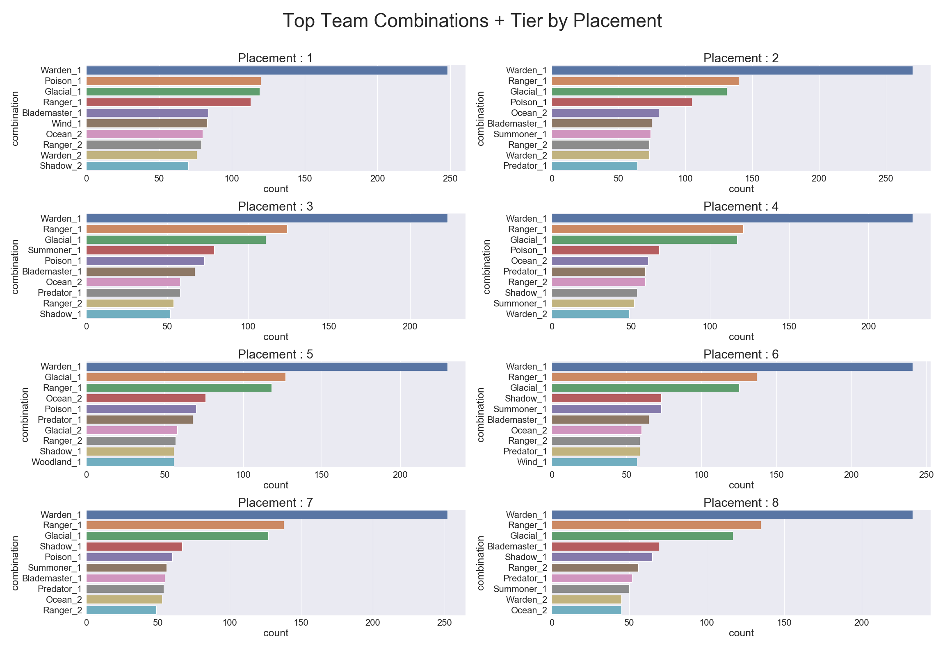
Initial Discovery

Slide 8
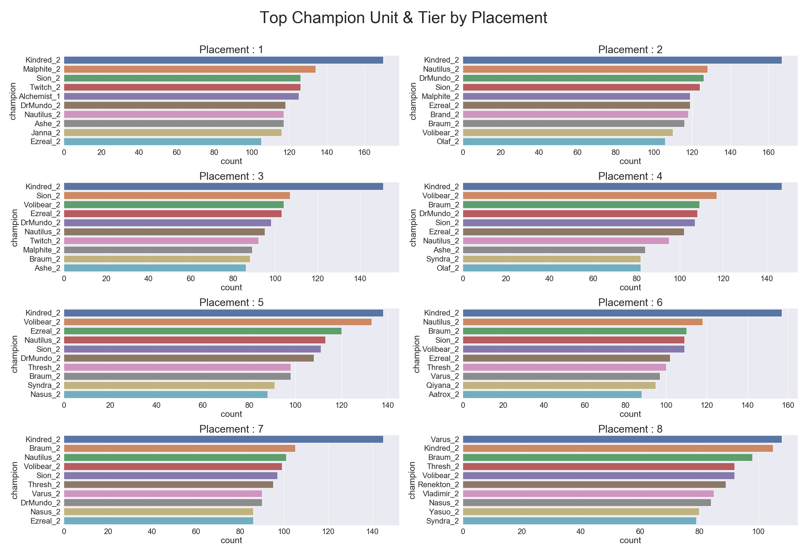
Initial Discovery

Slide 9
Multiclass Classification & Ensemble Methods
Model Selection
Decision Tree
Bagged Decision Tree
Random Forest
AdaBoost
XGBoost
Optimized using GridSearchCV
Tuned hyperparameters to improve accuracy of our model

Slide 10
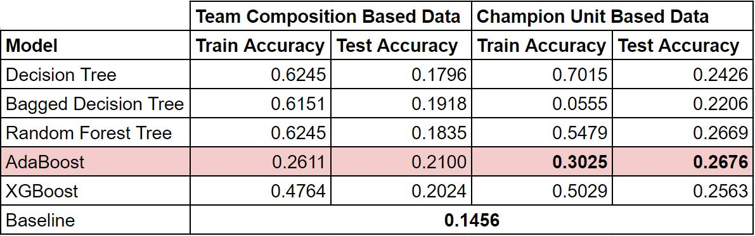
Accuracy Scores

Slide 11
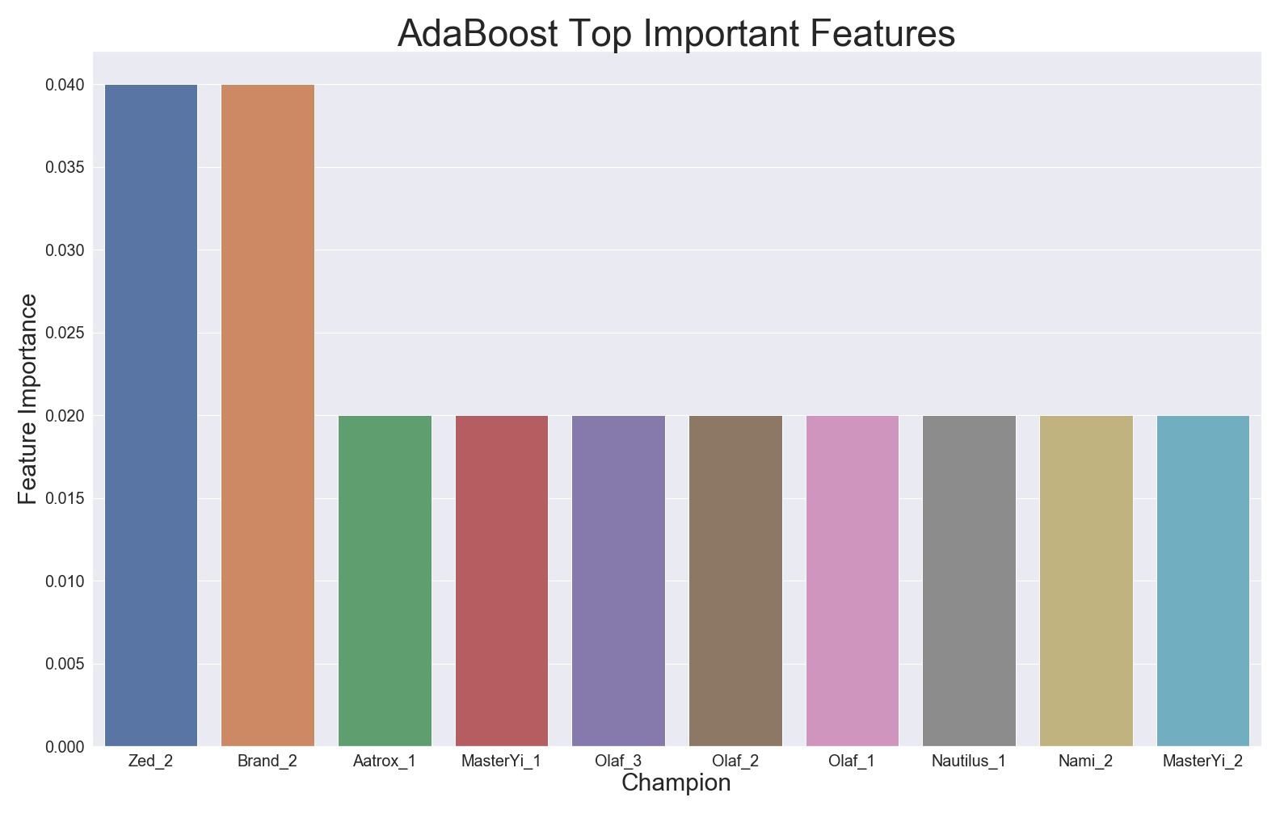
Most Important Features

Slide 12
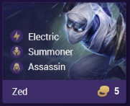
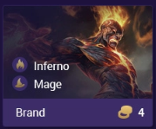
Conclusion
Using our scraped data from RIOT API, we were able to successfully come up with few models that may determine the placement of a player. We were able to achieve 26.8% accuracy for our testing set using AdaBoost ensemble method which performed much better than the baseline prediction of 14.6% accuracy. Using our best model, we were able to extract the most influential features to our model in particular Tier 2 Zed & Tier 2 Brand.

Slide 13
Limitations & Going Forward
Although we were able to successfully create a model that outperforms our baseline prediction %, the significance of our model in determining the most influential team composition or champion unit does not seem too reliable.
RIOT API for TFT data is still under development / RIOT only releases simplified data to the public as of now due to concerns of BOT creations
There are way too many strategic moves that can be made throughout different phases when our data only offers us the player’s information at the final moment before knockout or victory
Look forward until Riot decides to release additional game data!

Slide 14
Sources
https://developer.riotgames.com/
https://mobalytics.gg/guides-and-infographics/#tft

